Slide 1



Existing Website Content
Updated Website Content
About Us : Who are we
About Us : Who are we
Our VISION
To be the preferred destination for comprehensive construction solutions.
Our VISION To be the first preferred company for customized construction services in the industry.
Our MISSION
To provide quality construction and timely completion through enhanced construction tactics and practice with total commitment.
Our MISSION
We take pride in delivering reliable construction solutions with agility

Slide 2
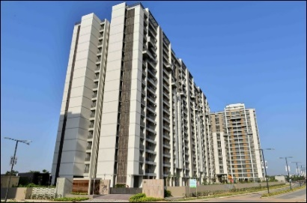
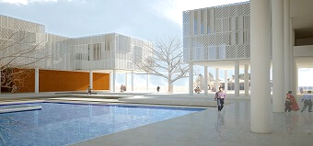
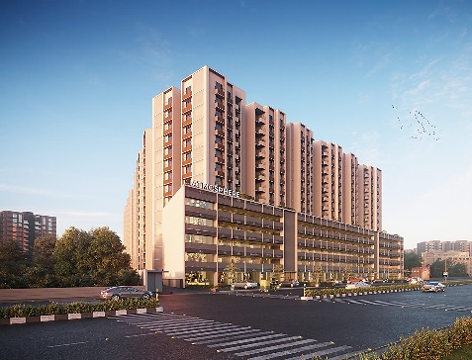
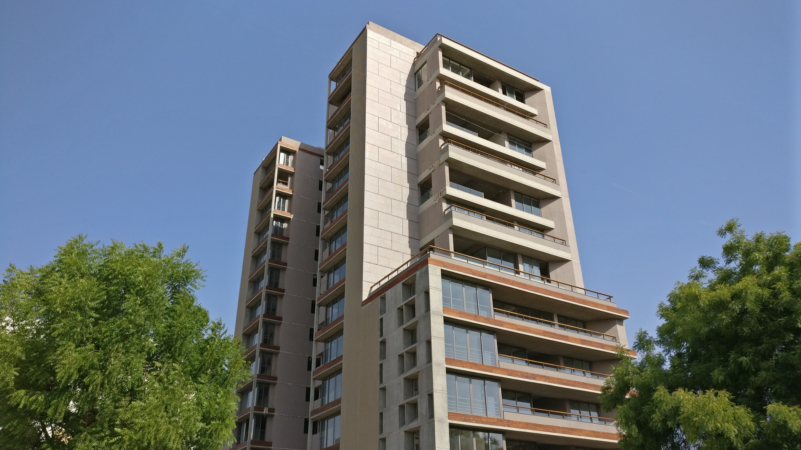
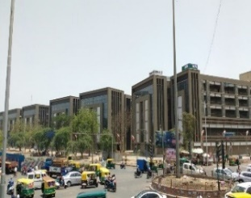
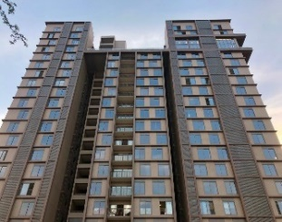
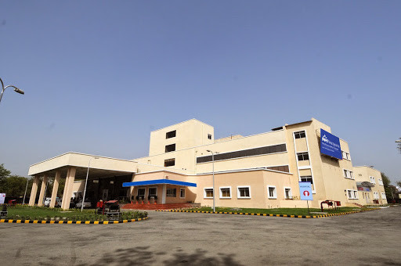
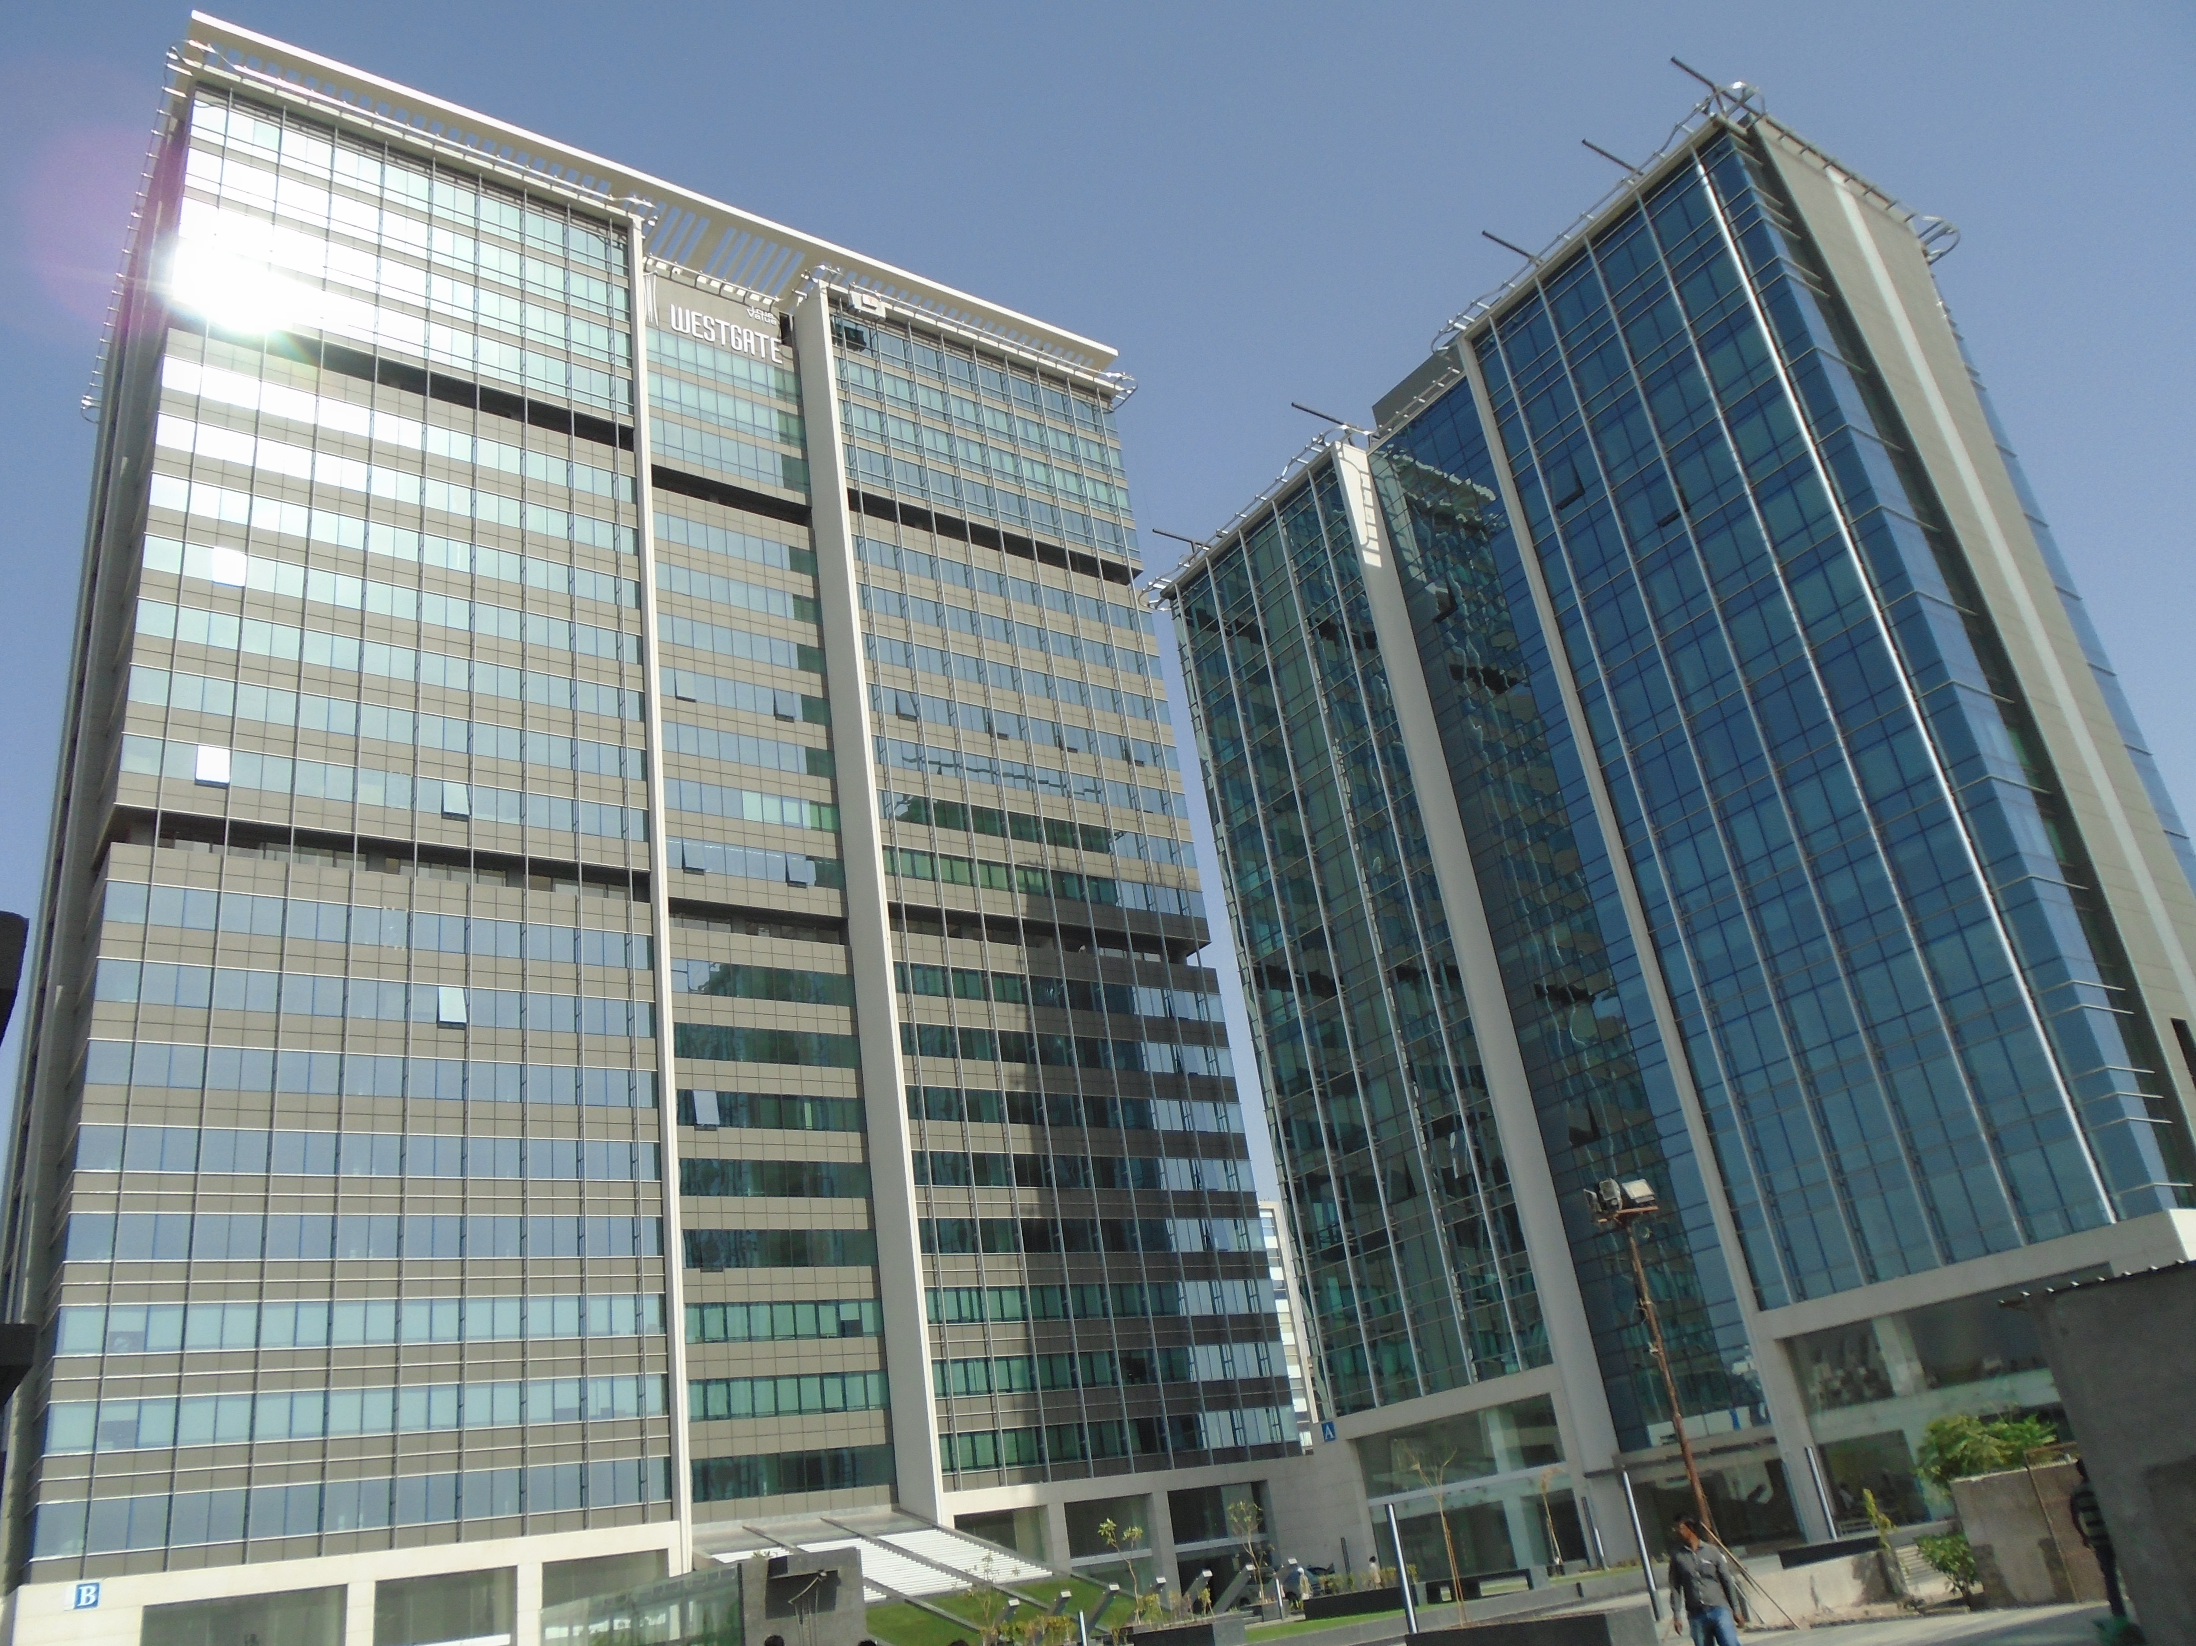
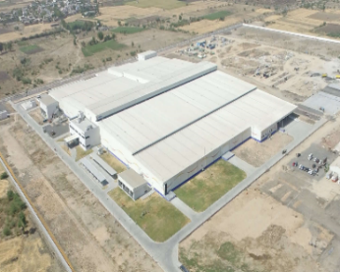
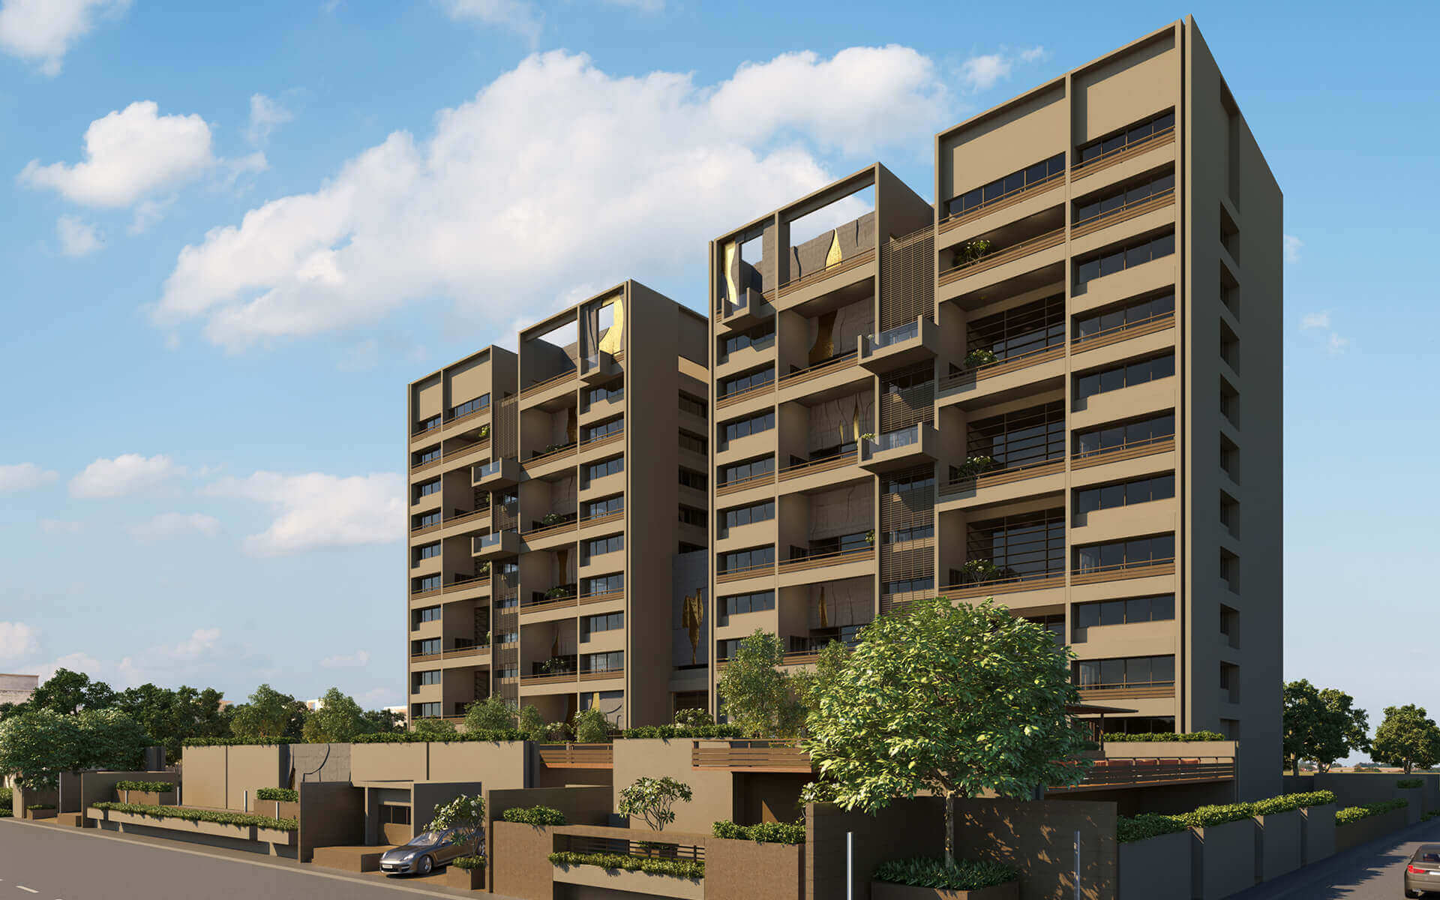
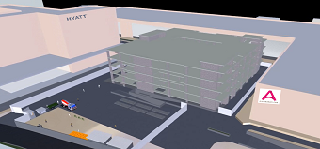
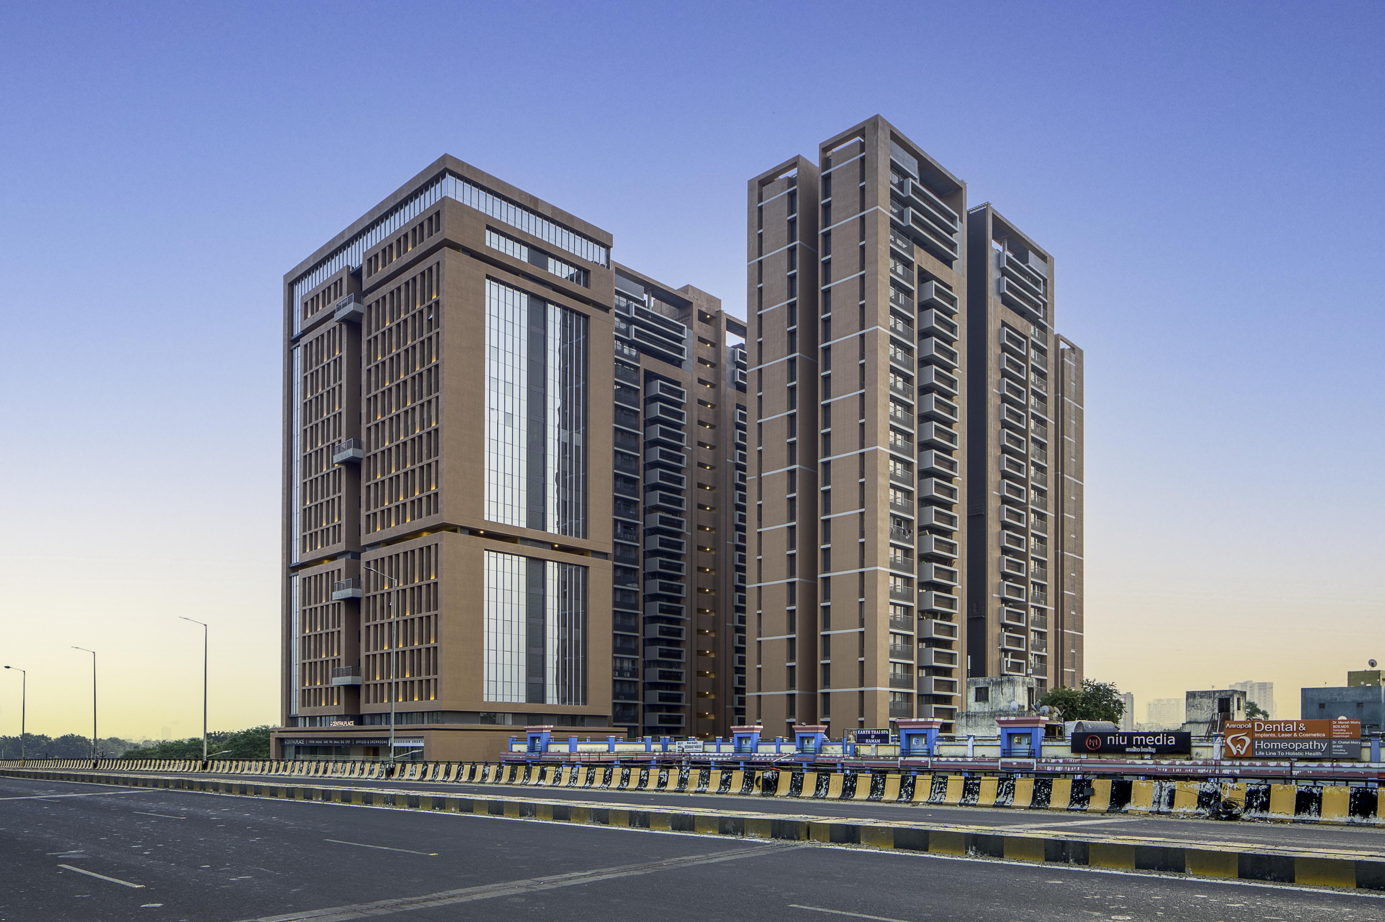
Existing Website Content
About Us : Our Milestones
Updated Website Content
Applewoods
Jain Heritage Museum
Sun Atmosphere
Sun Evoq
Sumel 8
12,50,000 SQFT
Largest ticket size project (Ongoing)
9,00,000 SQFT
Largest Built-up Residential project
16,00,000 SQFT
Largest Built-up Commercial project
One49
First luxurious Residential project
First 70 m tall Residential project
First Museum Project (Ongoing)
2012
2015
2016
2017
2018
2019
2020
2021
Narayana Hrudalay
Hospital
Westgate
Unicharm Factory
The Banyan
Ahmedabad One Mall Phase - II
Sun Sky Park
7,00,000 SQFT
Largest Built-up Industrial project
8,40,000 SQFT
Biggest Mix Development project
1,20,000 SQFT
Largest Built-up Institutional project
Tallest Commercial Building in Ahmedabad
The most luxurious Residential property in Ahmedabad
Most Complex Retrofitting Project

Slide 3
Existing Website Content
Updated Website Content
About Us : Address
About Us : Address Alignment
Address
Hi-Tech Projects Pvt. Ltd.
A-1401, Block-A, West Gate Business Bay
Besides Signature – 1, S.G.
Highway
Makarba, Ahmedabad - 380051. Gujarat. INDIA
Contact Us
Phone : +91-9904592200
+91-9904288900
Email : info@hitechprojects.co.in
Address
Hitech Projects Private Limited
A-1401, Block-A, West Gate Business Bay
Besides Signature – 1, S.G. Highway,
Makarba, Ahmedabad - 380051. Gujarat. INDIA
Contact Us
Phone : +91-9904592200 / +91-9904288900
Email : info@hitechprojects.co.in

Slide 4
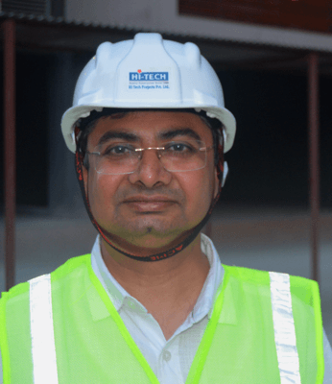
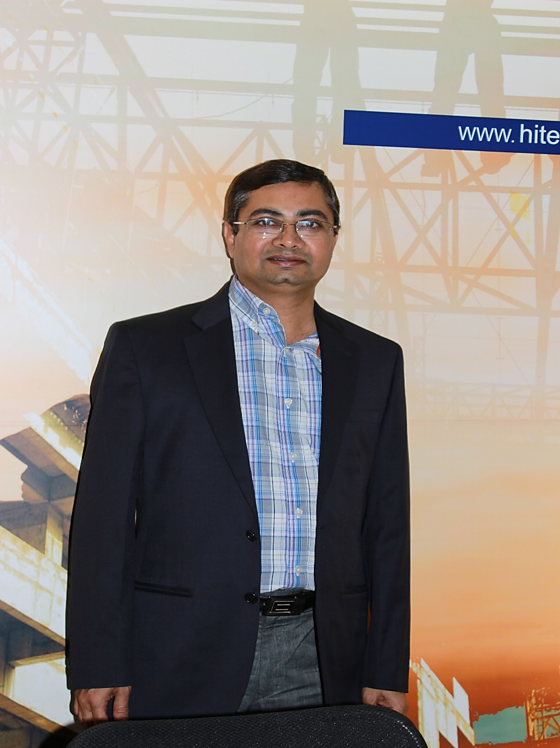
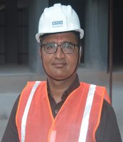
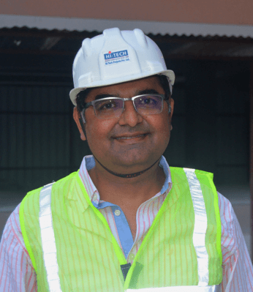
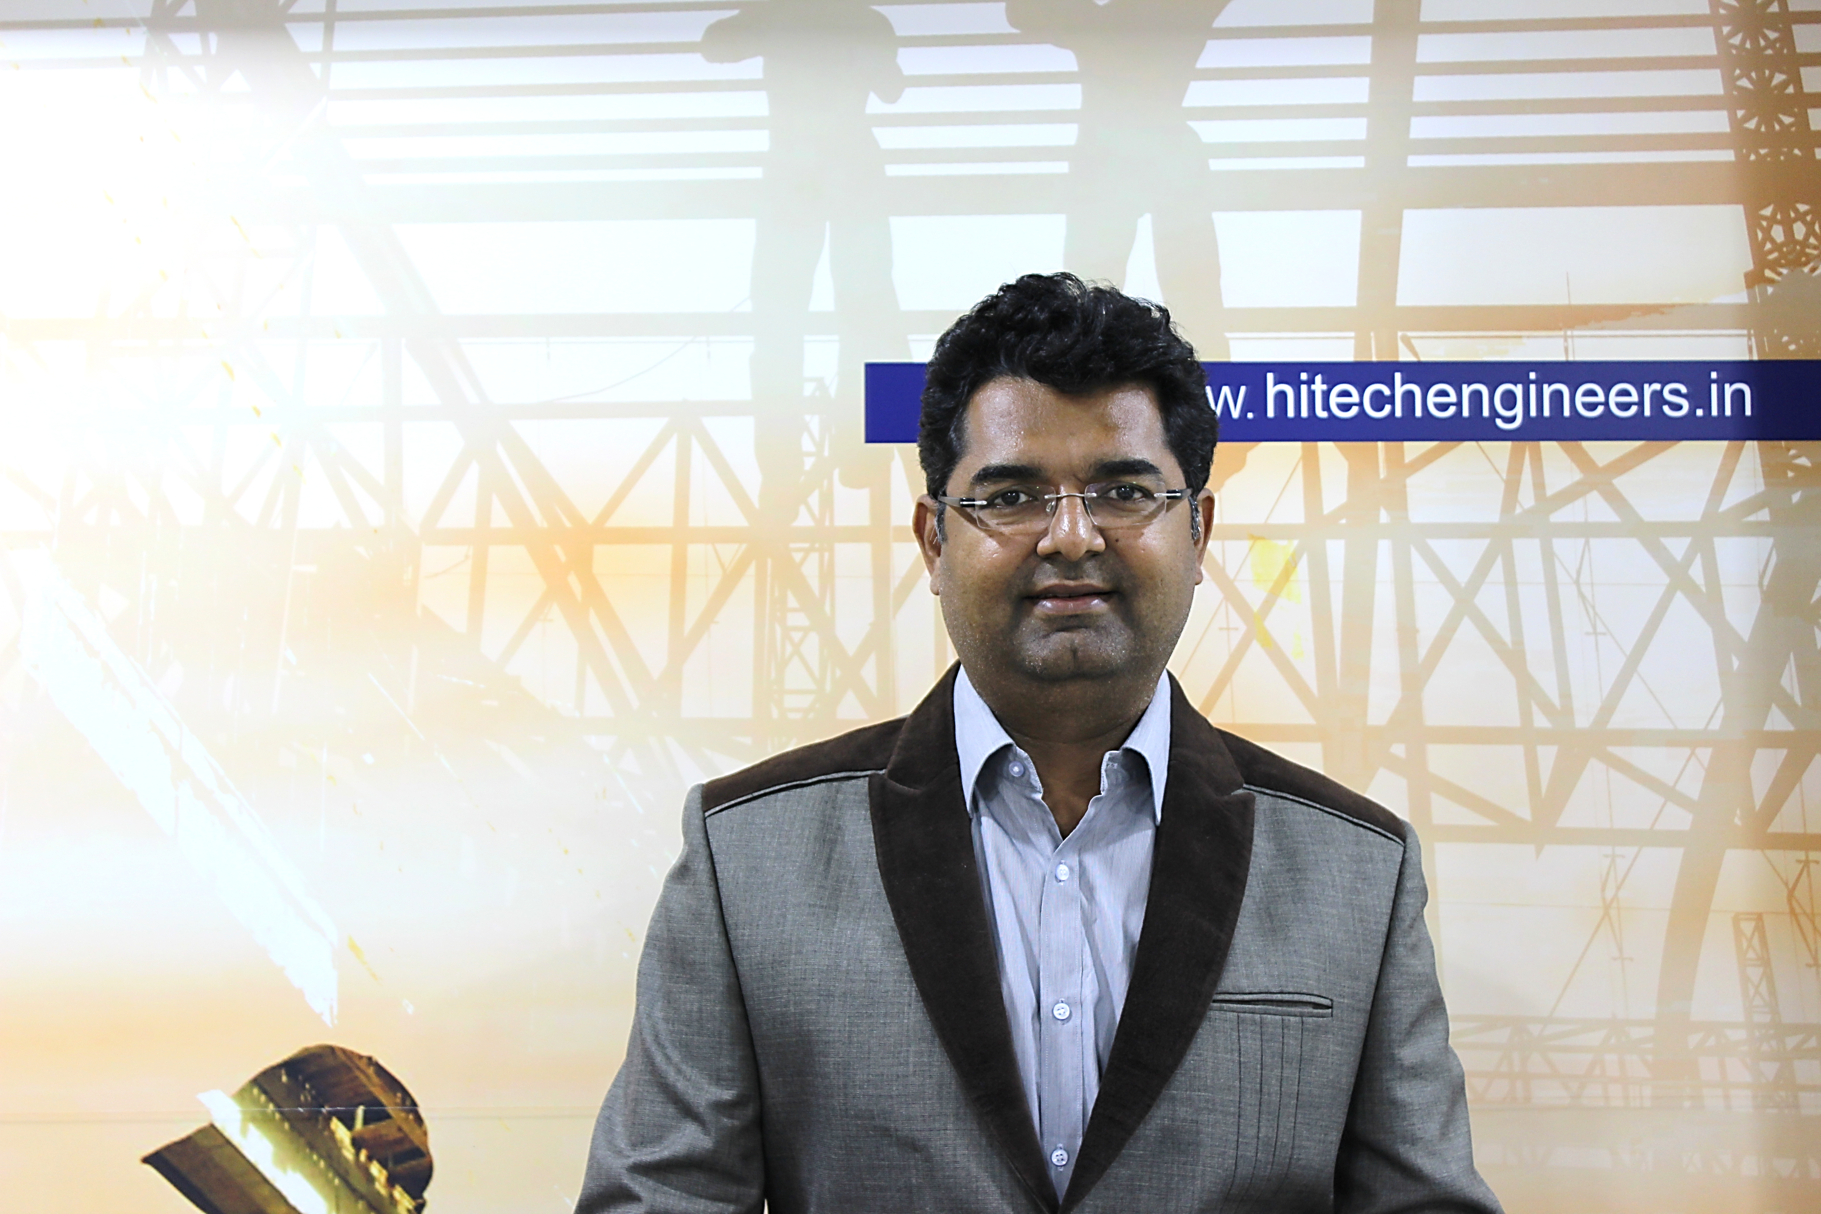
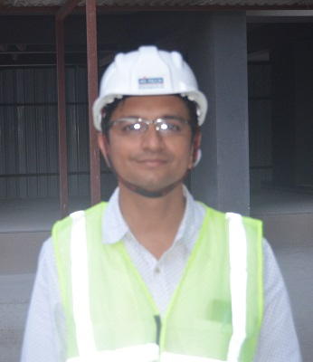
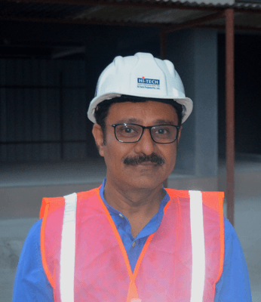
Existing Website Content
Updated Website Content
Management: Core Management
Management: Core Management
Munir Shah : Having 29 years of rich experience
Tejas Dalal : Having 29 years of rich experience
Manish Dave: Having 31 years of rich experience
Viral Shah : Having 25 years of rich experience
Jaydip Patel : Having 23 years of rich experience
Photos to be changed to newly Clicked - Professional

Slide 5
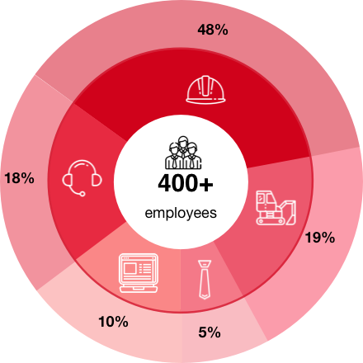
Existing Website Content
Updated Website Content
Our Team
Our Team
Our Family consists of: 470+
Engineers & Supervisors: 48%
Plant and Machinery Staff: 18%
Top Management: 5%
Managers & Above: 10%
Supporting Staff: 19%
Our Family consists of:
Engineers & Supervisors: 48%
Plant and Machinery Staff: 19%
Top Management: 5%
Managers & Above: 10%
Supporting Staff: 18%

Slide 6
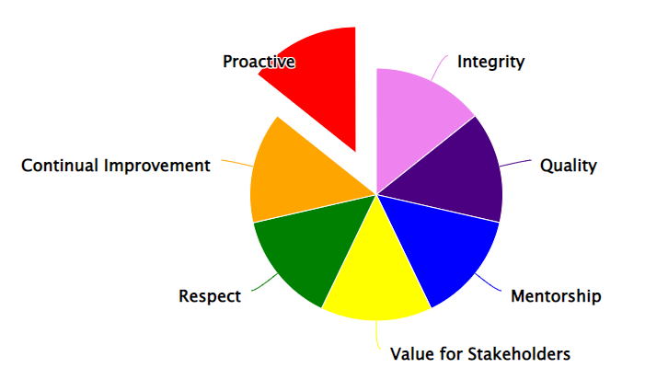
Existing Website Content
Updated Website Content
Core Values
Core Values
We have built our company around following 5 core values.
We have built our company around following 7 core values.
Continual Improvement
Trust
Caring
Accountability
Systemic Approach

Slide 7
Existing Website Content
Updated Website Content
Our Expertise
Our Expertise : No Changes

Slide 8
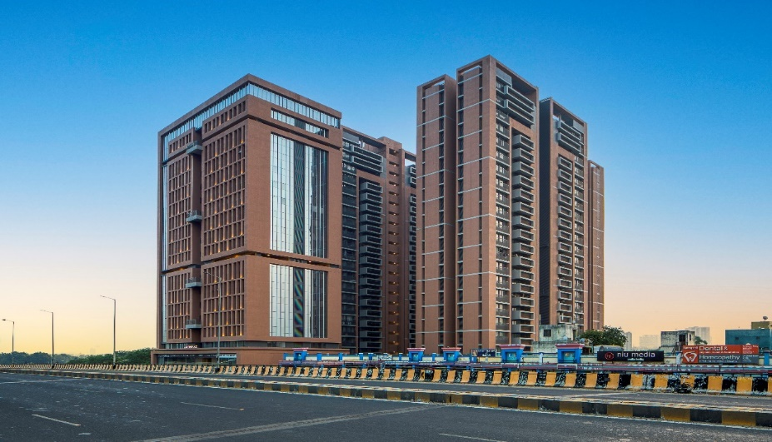
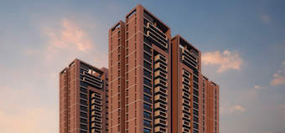
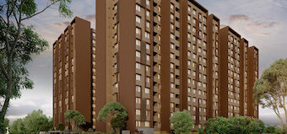
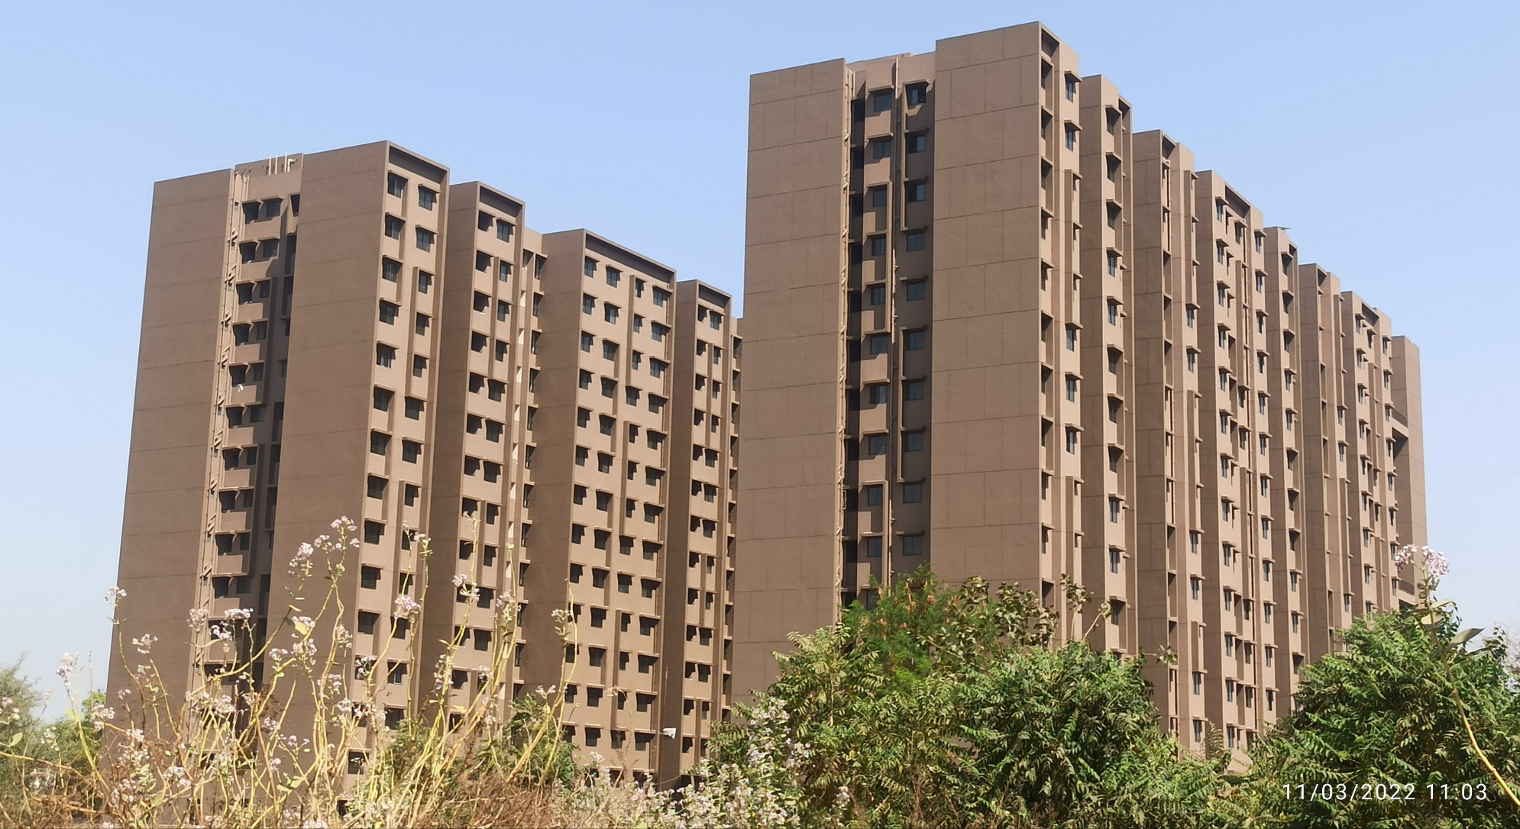
Existing Website Content
Updated Website Content
Projects: Residential
Projects: Residential
Ongoing:
Ongoing:
SUN SKY PARK
SUN SKY PARK :
Completed
ARVIND AAVISHKAR
Completed - 2022
ARVIND AAVISHKAR

Slide 9
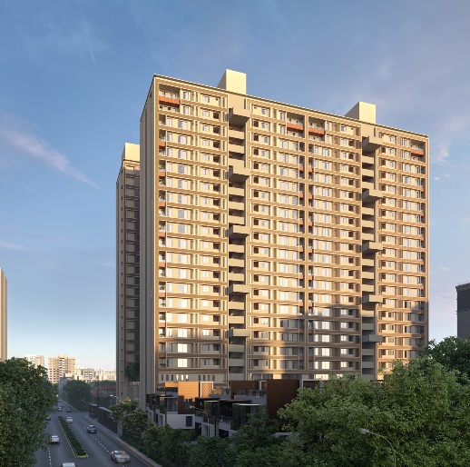
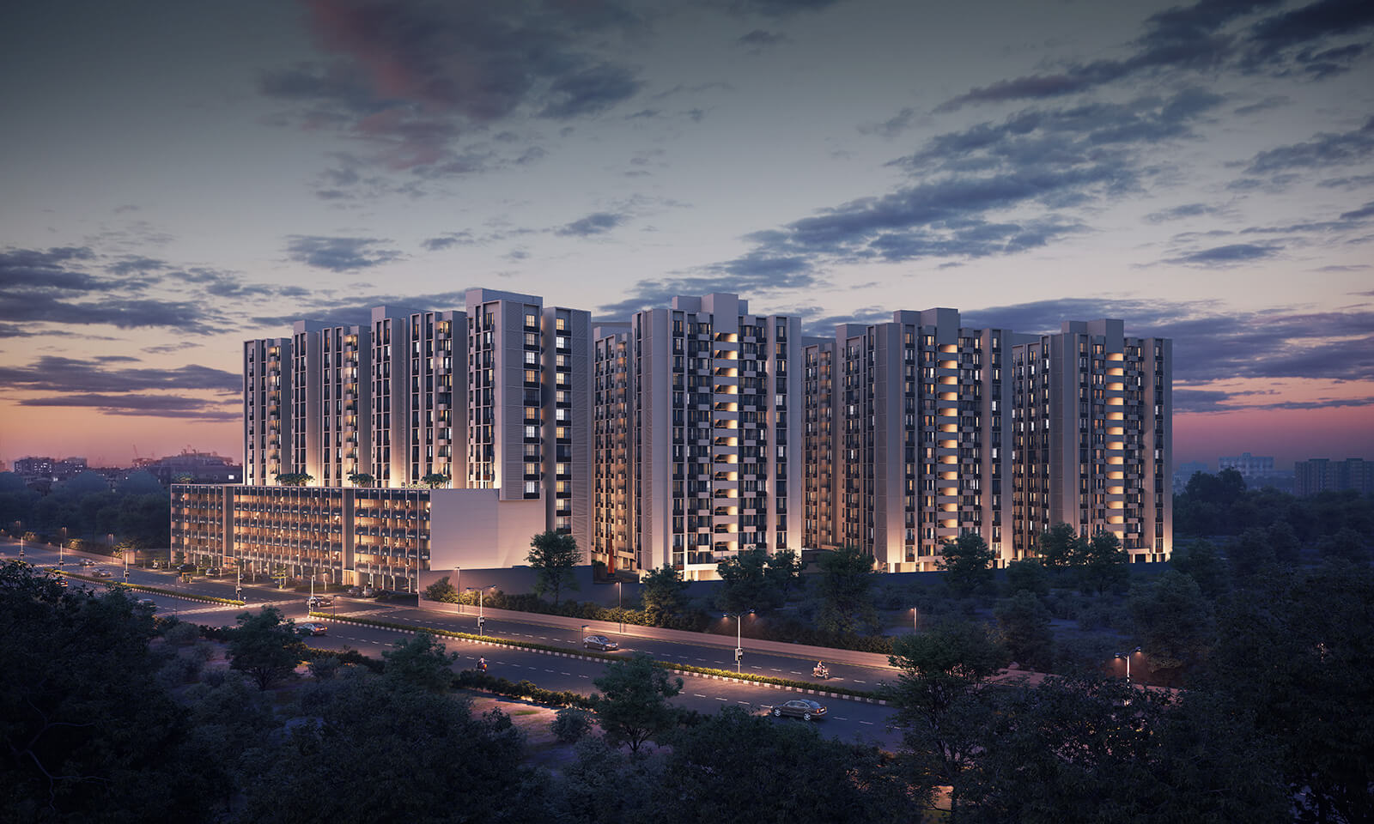
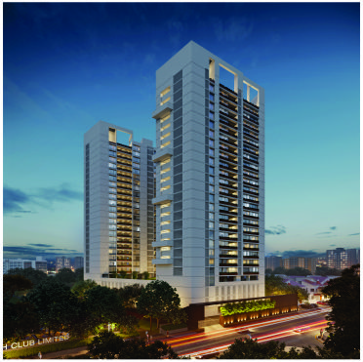
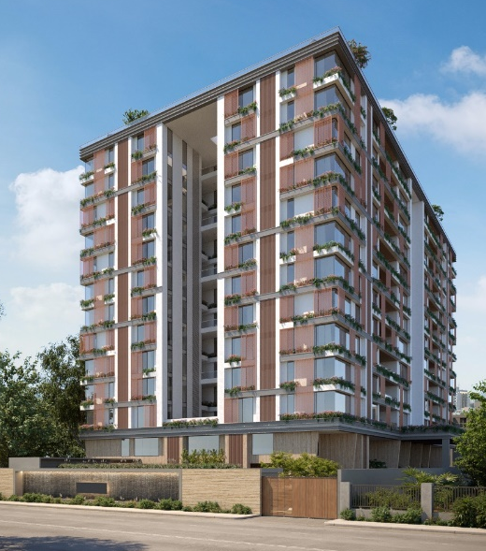
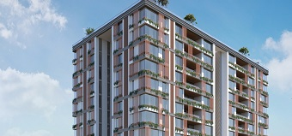
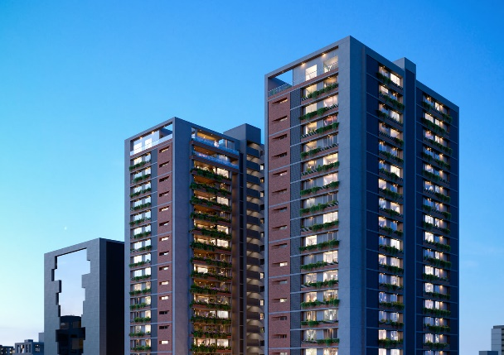
Existing Website Content
Updated Website Content
Projects: Residential
Projects: Residential
Ongoing:
Ongoing:
VENUS PASHMINA
4 & 5 BHK regal apartments
SUN ATMOSPHERE
Sun Atmosphere are
2 to 3 BHK apartments
OEUVRE -2
4 BHK spacious and
luxurious apartments,
the architectural design and
modern amenities that
Oeuvre-2 entails is remarkable
THE WATERFALL
NORTHWEST/GHARANA
5 & 6 BHK Sky Villas of 22 floored
structure

Slide 10
SUN SKY PARK |  | SUN ATMOSPHERE |  | OEUVRE -2 |  | GHARANA/NORTHWEST |  | VENUS PASHMINA
Welcome to a new perspective to city living in Ahmedabad through Community, Central Park, Club, Homes, Penthouse etc. |  | Sun Atmosphere are 2 to 3 BHK apartments & Retail at Shela |  | 4 BHK spacious and luxurious apartments, the architectural design and modern amenities that Oeuvre-2 entails is remarkable |  | 5 & 6 BHK Sky Villas of 22 floored structure |  | 4 & 5 BHK regal apartments
Segment : Residential |  | Segment : Residential |  | Segment : Residential |  | Segment : Residential |  | Segment : Residential
Client: Shilp Developers- Sun Builders |  | Client: Sun Realty |  | Client: Madhav Oeuvre-2 LLP - Madhav Group |  | Client: Sheetal Infrastructure |  | Client: Sarthi Prospace LLP-Venus Lifespace Creators
Project Size: 8,41,464 Sq. ft. (2B+G+22 Floors) |  | Project Size: 1,25,000 Sq. ft. (16 Blocks- 2B+G+14 Floors) |  | Project Size: 6,05,957 Sq. ft. |  | Project Size: 5,00,000 Sq. ft. |  | Project Size: 8,89,160 Sq. ft. ( 2B+G+2P+HP+19 Floors)
Architect: Placekinesis Associates |  | Architect: H M Architects |  | Architect: H M Architects |  | Architect: ADS Architect |  | Architect: H M Architects
Str. Consultant: Setu Infrastructure |  | Str. Consultant: Setu Infrastructure |  | Str. Consultant: Setu Infrastructure |  | Str. Consultant: Ducon Consultants |  | Str. Consultant: Setu Infrastructure
Scope: Civil Structure Work with Finishing & Services |  | Scope: Civil Structure work for RCC works, Block work, Internal plaster, External Plaster |  | Scope: Civil Structure work for RCC works, Block work, Internal plaster, External Plaster |  | Scope: Civil Structure work for D Wall, RCC works, Block work, Internal plaster, External Plaster |  | Scope: Civil Structure work for RCC works, Block work, Internal plaster, External Plaster

Slide 11

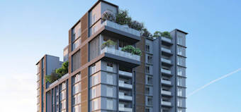

Existing Website Content
Updated Website Content
Projects: Residential
Projects: Residential
Completed:
Completed:
SUN SKY PARK
Sun Skypark Ambli has 3
towers, with 22 floors each
and 252 units with 3BHK,
4BHK and 5BHK
ONE 49
ARVIND AAVISHKAR
Arvind Aavishkaar at Naroda Road is loaded with amenities, plush and affordable 2 BHK homes

Slide 12
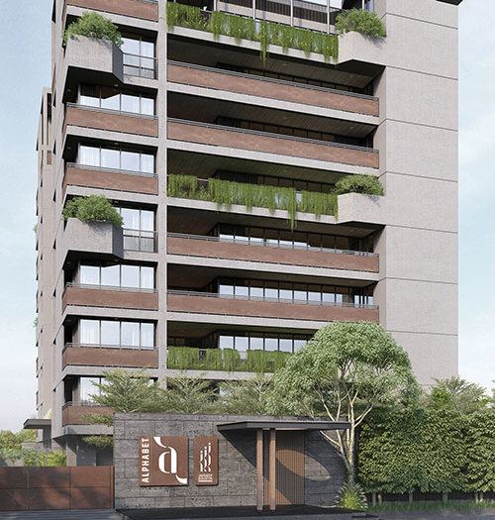
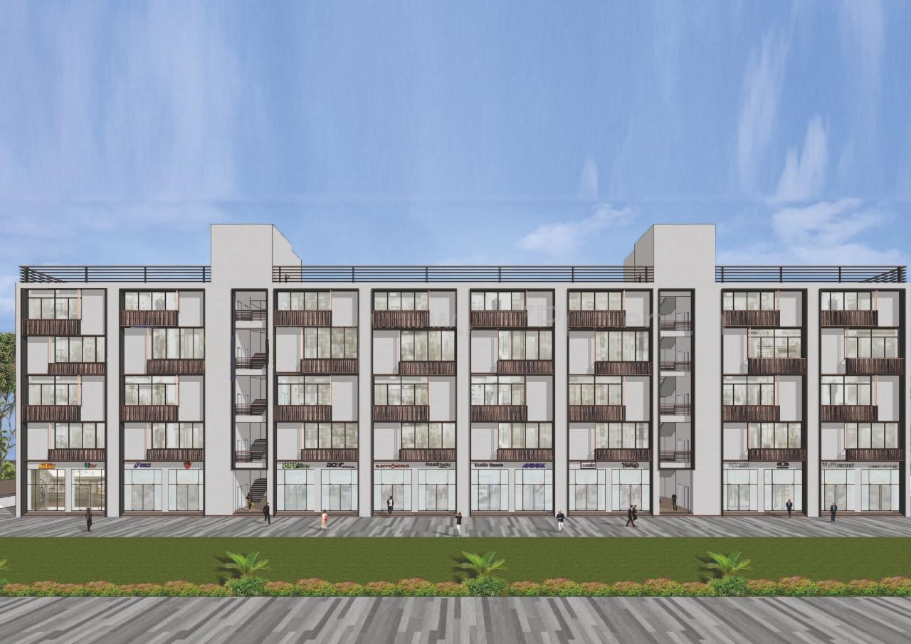
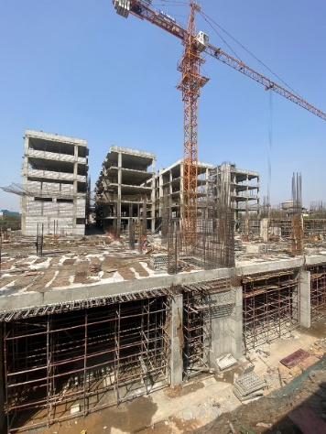
Existing Website Content
Updated Website Content
Projects: Commercial
Projects: Commercial
Ongoing:
Ongoing:
To be Shifted to Completed
ALPHABET
1. KP EPITOME
2. SHARNAM SOLITAIRE
3. SHIVALIK SHILP II
SHARNAM METROLINK
To be REMOVED
1. MONDEAL BUSINESS PARK
2. SUMEL BUSINESS PARK IV
3. SUMEL BUSINESS PARK V

Slide 13
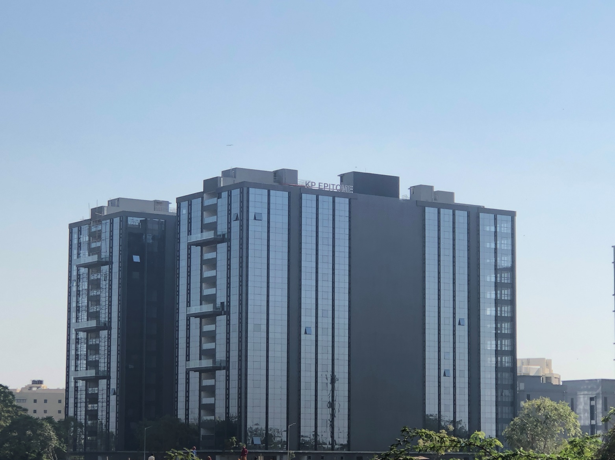
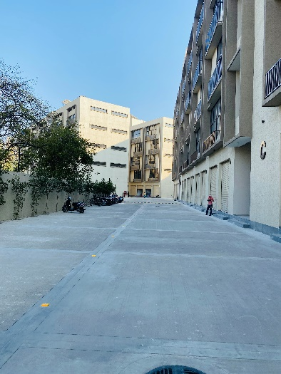
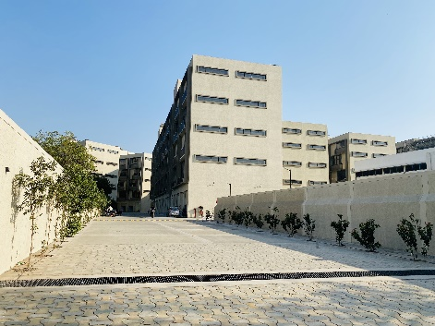
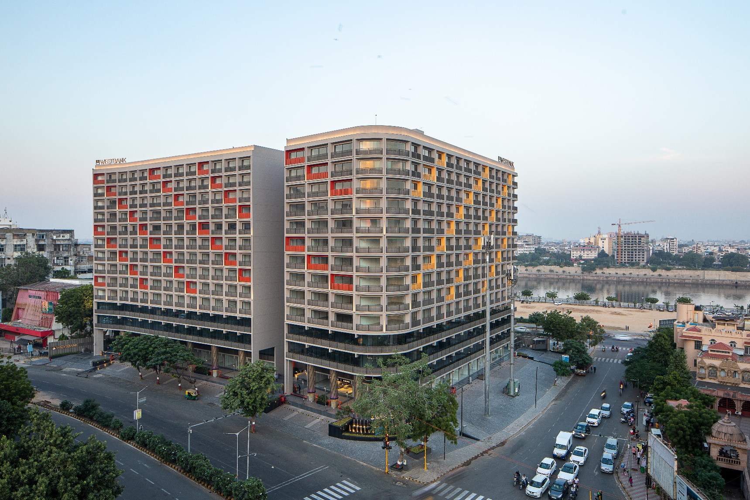
Existing Website Content
Updated Website Content
Projects: Commercial
Projects: Commercial
Ongoing:
Completed:
To be SHIFTED TO COMPLETED
K P EPITOME
1. KP EPITOME
2. SHARNAM SOLITAIRE
3. SHIVALIK SHILP II
SHARNAM SOLITARE
SUN WEST BANK

Slide 14
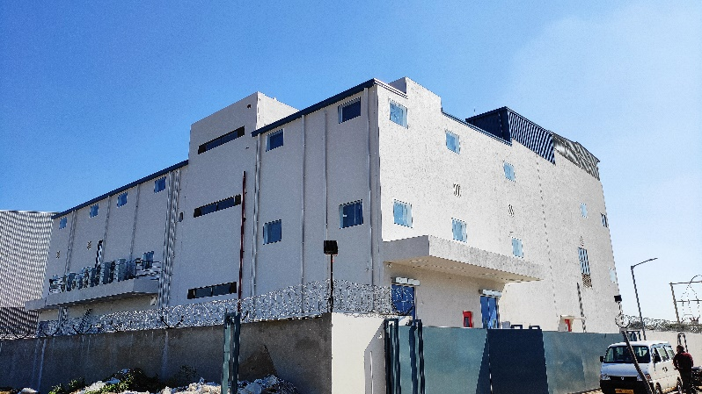
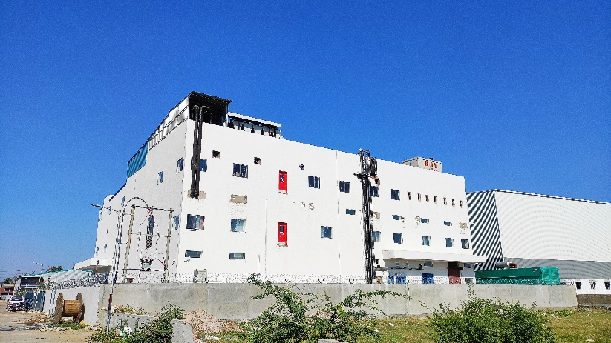
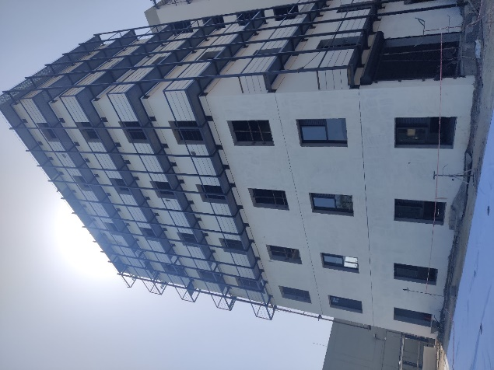
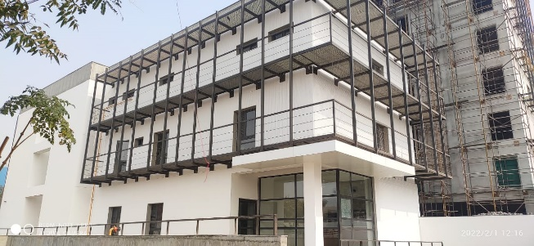
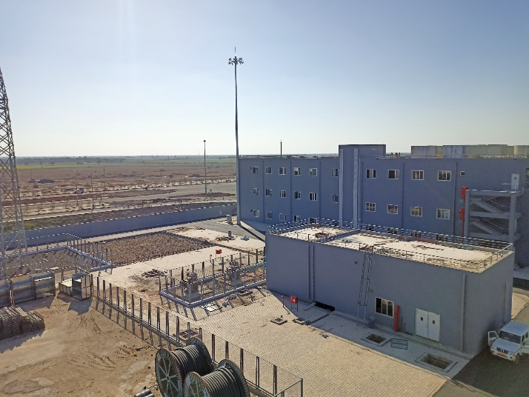
Existing Website Content
Updated Website Content
Projects: Industrial
Projects: Industrial
Ongoing:
Completed:
To be SHIFTED TO COMPLETED
FINECURE PHARMA
1. TORRENT ODHAV
2. TORRENT DHOLERA
3. FINECURE PHARMA
TORRENT ODHAV
TORRENT DHOLERA

Slide 15
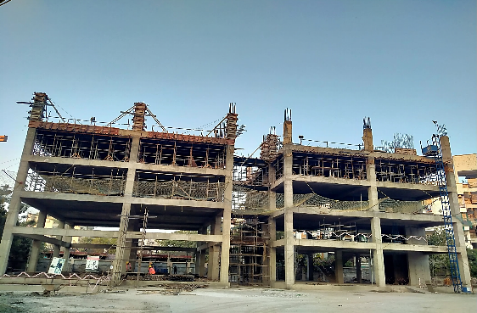
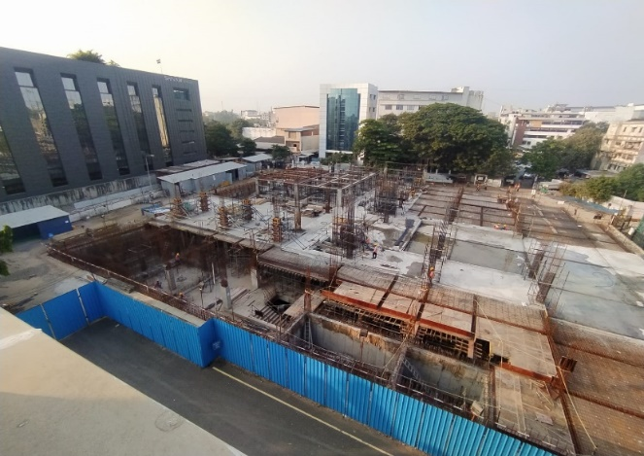
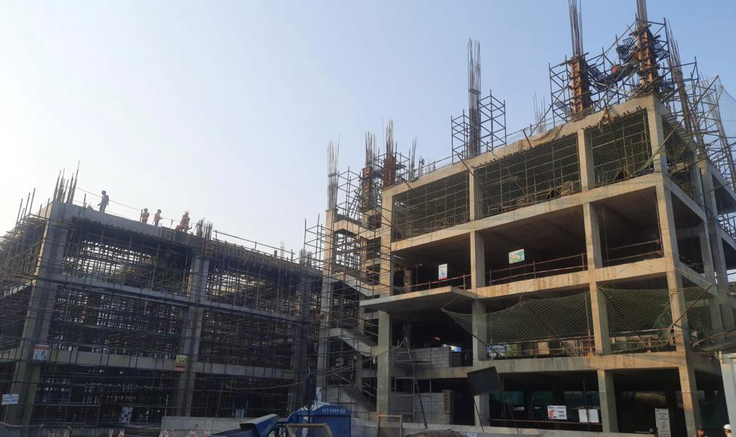
Existing Website Content
Updated Website Content
Projects: Industrial
Projects: Industrial
Ongoing:
Completed:
Projects to be added
TORRENT NARANPURA
1. RELIANCE JAMNAGAR
TORRENT SURAT B STATION
TORRENT SURAT E STATION

Slide 16
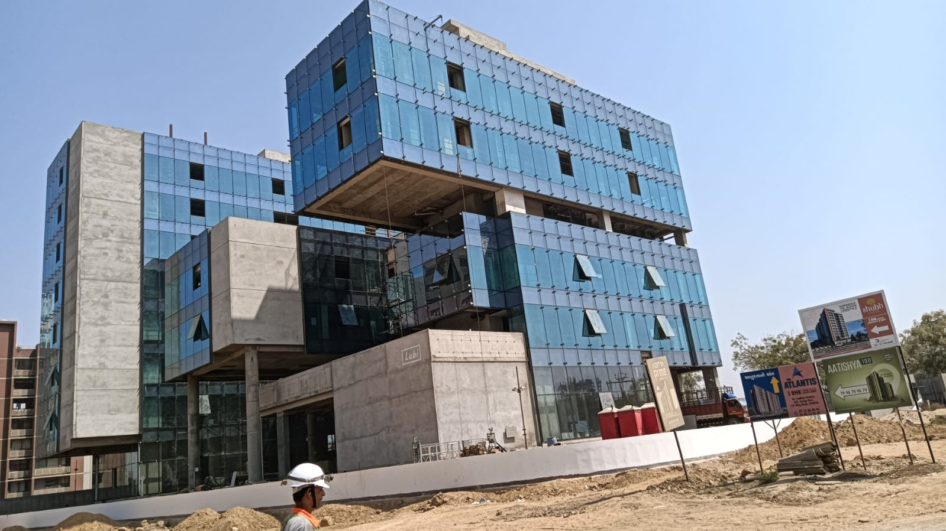
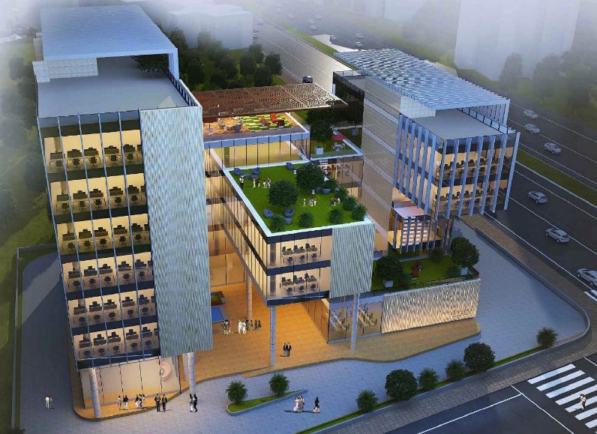
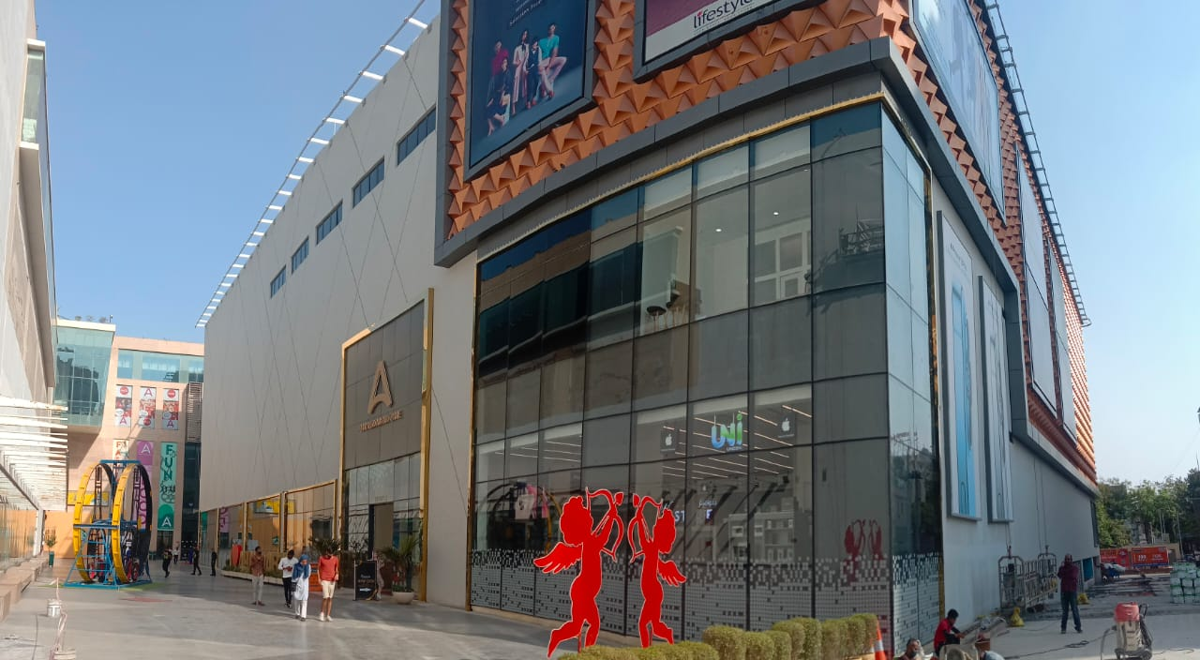
Existing Website Content
Updated Website Content
Projects: Institutional/Corporate
Projects: Institutional/Corporate
Ongoing:
Completed:
To be SHIFTED TO COMPLETED
Lubi
1. Lubi
2. Ahmedabad One Mall

Slide 17




Existing Website Content
Updated Website Content
Projects: Institutional/Corporate
Projects: Institutional/Corporate
Ongoing:
Completed:
Koba

Slide 18




Existing Website Content
Updated Website Content
Projects: Institutional/Corporate
Projects: Institutional/Corporate
Ongoing:
Ongoing:
ANANT UNIVERSITY
JITO HOSTEL

Slide 19




Existing Website Content
Updated Website Content
Our Clients
Our Clients

Slide 20

Existing Website Content
Updated Website Content
Our Architect and Consultants
Our Architect and Consultants
Remove SYNERGY and Add COLLIERS

Slide 21
VISION
To be the preferred destination for comprehensive construction solutions
Preferred destination means first choice amongst present & potential customers
Comprehensive Construction Solutions means design, actual construction, construction services including core and shell, facade, interiors and MEP

Slide 22
MISSION
We take pride in delivering reliable construction solutions with agility
Reliable means on time and as per the quality standards as agreed with the client
Agility means behaviour that indicates quick response time, continuous improvement and the ability to be adaptive & flexible as required
Reliable means behaviour that generates a sense of dependability, trust, integrity in our stakeholders – whether it is with clients, fellow employees, contractors, labour, bankers, vendors or other business associates. We say what we mean and we do what we say. We honour our commitments to deliver quality specifications within timelines.
Mission for each one of us is to strive to be reliable – to demonstrate that characteristic in our every day behaviour, for example, which makes our client come back to us with repeat business. It contributes towards fulfilling our Vision that is, making us ‘a preferred destination’.
Agility means proactively sensing and responding to the change in the environment in which we operate. For individual employees, agility involves anticipating what might happen, managing the unexpected, and adapting to new situations. Not only does business agility help you adjust to market changes, but it also helps you grow, change and adapts to internal and external changes, shifts and trends in a VUCA world. Having a framework that prepares your business for change makes you even stronger.

Slide 23
VALUES
Continuous Improvement means we focus on optimizing every process in our company by focusing on those activities that generate the most value for our clients and stakeholders, while removing as many redundancies as possible. We continuously strive to improve our construction technology, our equipment, our standards of excellence , our process methodologies. We take continuous actions to build competence levels & skill sets of our people.
Trust means we deliver what we have committed to our clients as per timelines and as per agreed quality & safety standards. Trust means we accept people for who they are and trust them to perform their role as required.
Caring means we feel genuine concern, kindness for others and express ourselves through caring actions. Even if we have to take tough decisions they are carried out in a manner that demonstrates our care and respect for the other person.
Accountability means that each and every one of us is willing to accept and own our individual responsibilities and account for our actions. At the same time we ensure that collectively as a team, we hold each and every member of the team responsible for their actions towards achievement of common goals.
Systemic Approach means that all our actions are well planned, standard operating practices are defined, all business processes are streamlined, having integrated systems in place for all activities for smooth co-ordination between projects and functions. We incorporate proven practices, software supported systems and technology in all our functional processes.

